Slide 1

School fee management system
COMPUTER PROJECT
NAME : ARNAB DEY
ROLL NO : 21
CLASS : 12B

Slide 2
CERTIFICATE
Certified that this is a Bonafide project work
done by
Arnab Dey
Roll No.21Of class XIIB
kendriya Vidyalaya No 2,
Nausenabaugh,Visakhpatnam during the
academic year 2025-2026
Computer Teacher

Slide 3
ACKNOWLEDGEMENT
I would like to thank my Computer teacher PRASANTHI MAM for the guidance that he provided me in this project. His knowledge has provided me with great help.
I would like to thank our Principal Sir for all the resources that he provided for this project.
I also thank my parents for the support and motivation that they have provided; without them, I would not have been successful in making this project.

Slide 4
INDEX
Introduction
Program
output
conclusion

Slide 5
introduction
The School Fee Management System is a software application designed to simplify and streamline the process of managing student fees. It helps schools efficiently track payments, generate invoices, manage due balances, and provide reports for better financial oversight.
This system reduces manual workload, minimizes errors, and ensures transparency in fee collection, making financial management easier for both administrators and parents.

Slide 6
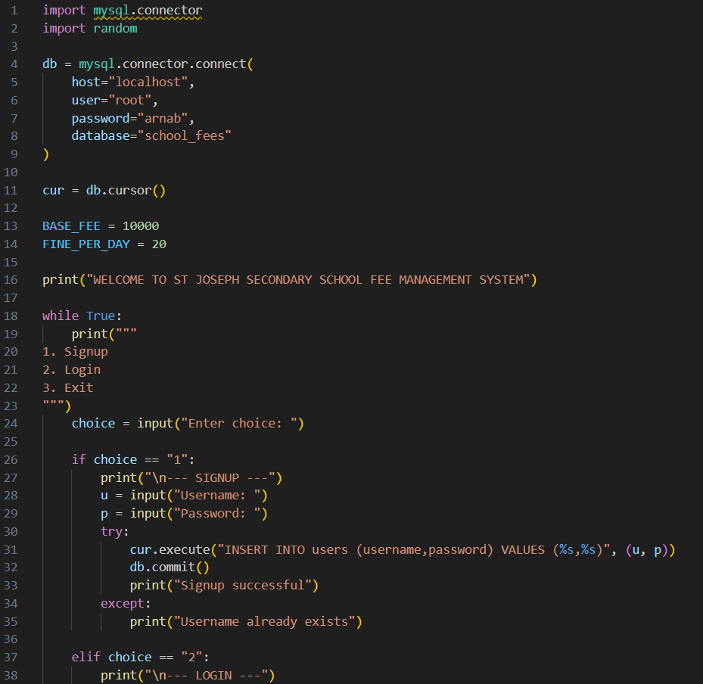
program

Slide 7
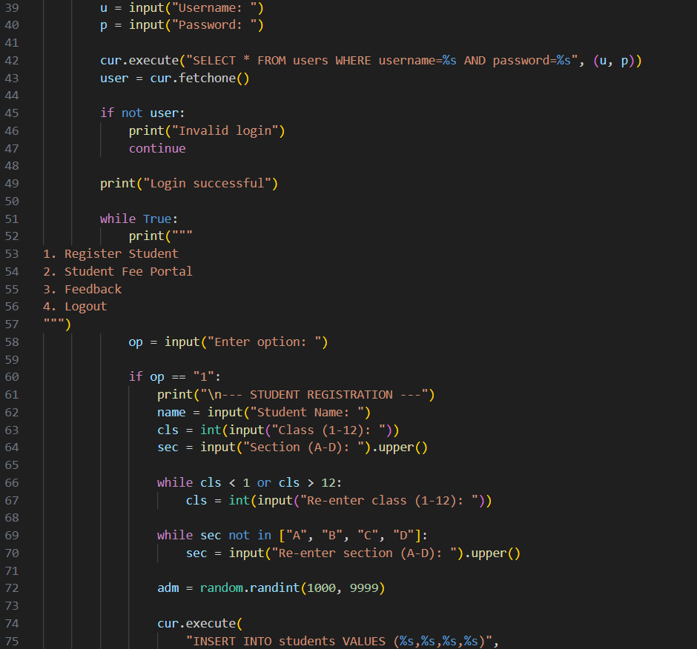

Slide 8
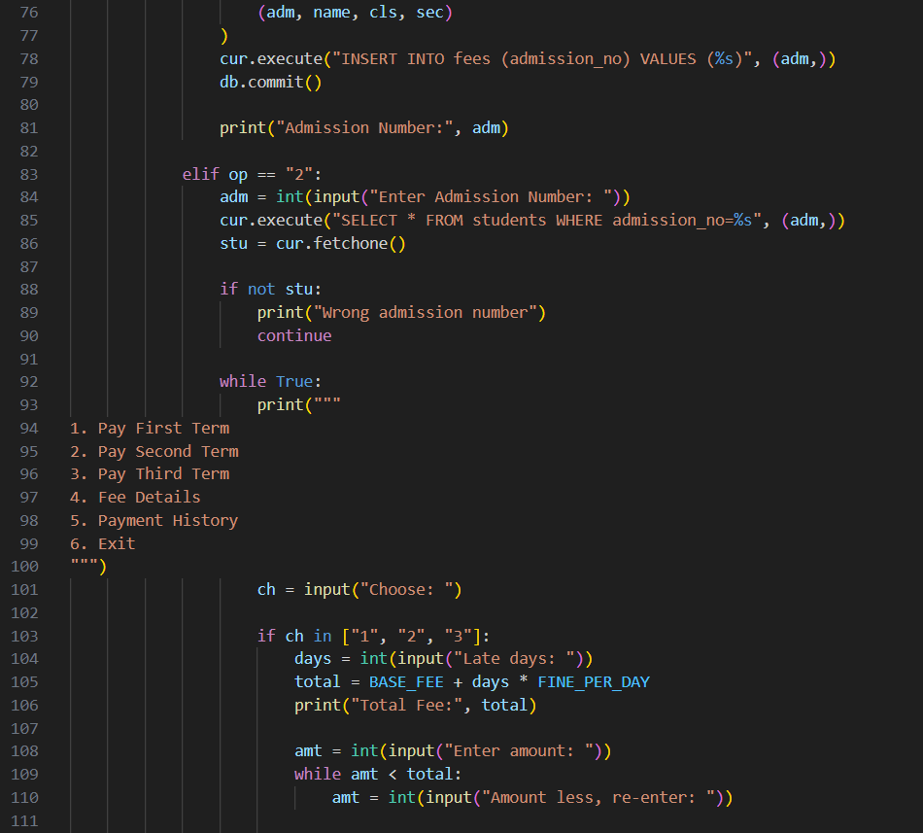

Slide 9
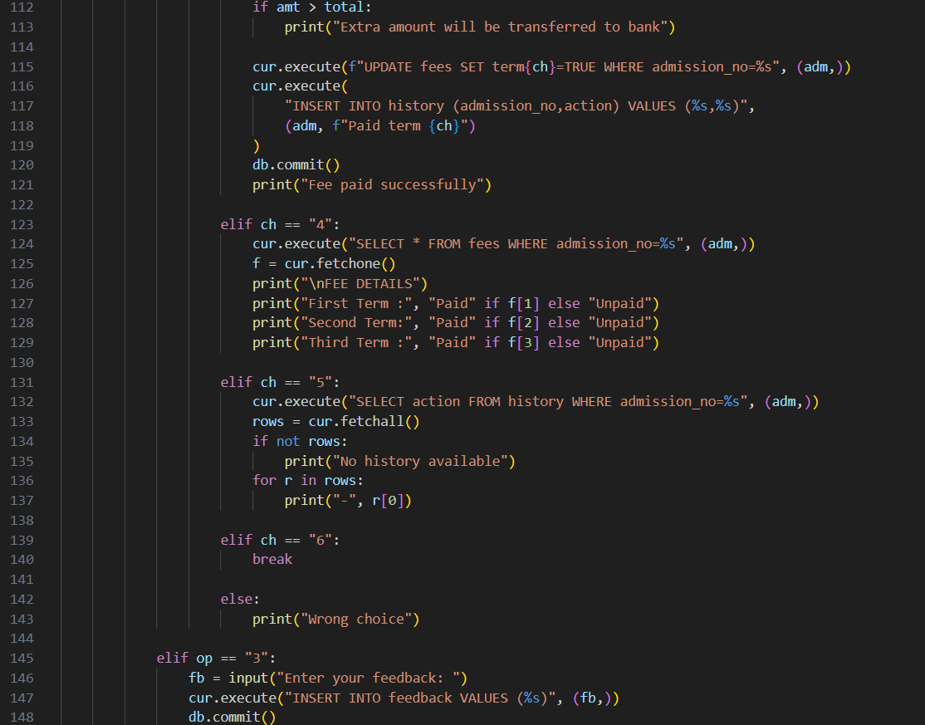

Slide 10
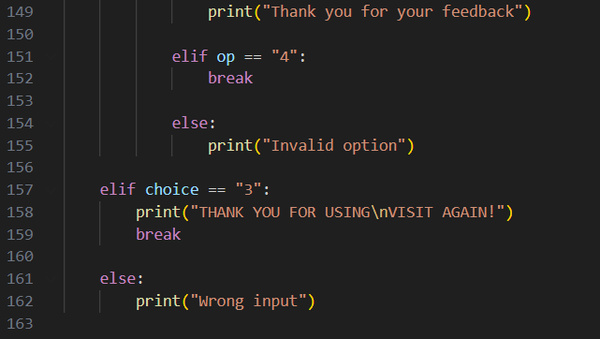

Slide 11
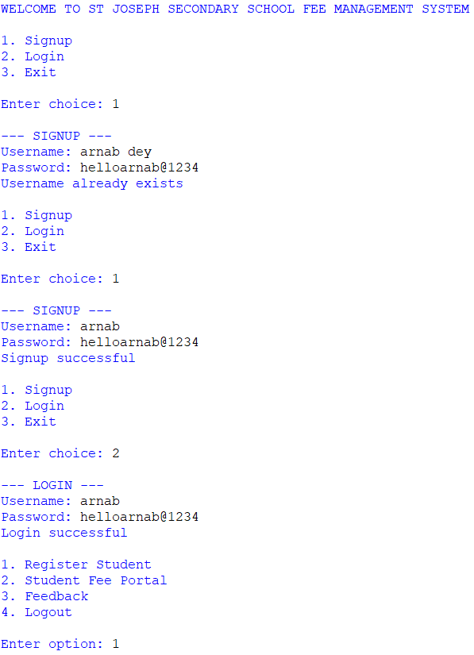
output

Slide 12
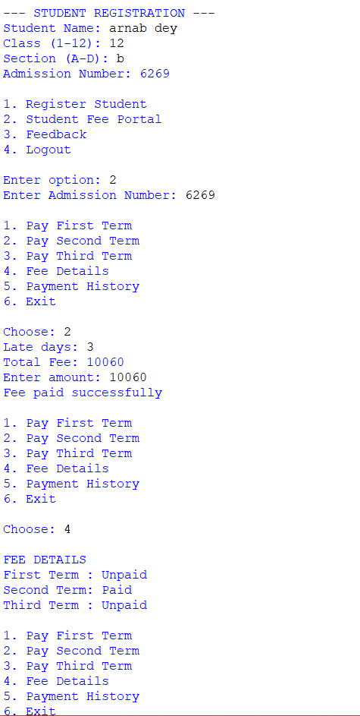

Slide 13
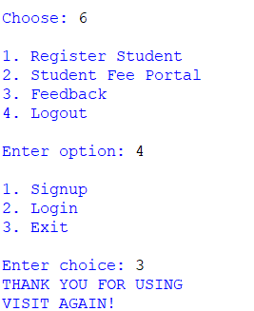

Slide 14

CONCLUSION
HOPE,YOU ALL LIKED THIS PRESENTATION ON SCHOOL FEES MANAGEMENT SYSTEM
DISPLAYED AND EXPLAINED BY OUR GROUP.THIS FEE MANAGEMENT SYSTEM WILL
HELP TO SORT OUT THE OLD PROBLEMS OF SEARCHING THE FEE RECORDS OF
STUDENTS FROM THE BULK OF PAPERS.COMPUTERZATION HAS HELPED THE SCHOOL
A LOT AS IT HAS SAVED THE TIME AND ENERGY TO COLLECT THE FEES OF A STUDENT
AND THE DETAILS.THIS IS MADE WITH THE EFFORTS BY OUR GROUP AND CAN BE USED
FOR THE FEE MANAGEMENT SYSTEM IN ANY SCHOOL.THANKING YOU ALL FOR
CO-OPERATING WITH US IN SHOWCASTING THIS SYSTEM.

Slide 15


THANK YOU

